Slide 1
CSIT 404 VOICE COMMUNICATION TECHNOLOGY
Session 5 – Call Signaling over Digital Voice Ports
Lecturer: Mr. Paul Nii Tackie Ammah, CSD
Contact Information: pntammah@gmail.com

Slide 2
Session Overview
The session introduces basic configuration of digital voice ports and demonstrates how to fine-tune voice ports with port-specific configurations.
At the end of the session every student should be able to
describe the various digital interfaces

Slide 3
Session Outline
The key topics to be covered in the session are as follows:
Digital Voice Ports

Slide 4
Digital Voice Ports
Topic One

Slide 5

Introduction
Enterprise networks often use digital circuits, in contrast to analog circuits, when inter-connecting their Voice over IP (VoIP) network to traditional telephony environments (PSTN or PBX).
One major advantage of using digital circuits is the economies of scale made possible by transporting multiple conversations over a single circuit.
Many enterprises also have the need to interconnect PBX systems, and these PBXs might be from different manufacturers.
In many cases, two PBXs from different manufacturers can be interconnected via a digital circuit.

Slide 6
Digital Voice Ports
Digital trunks are used to connect to the PSTN, to a PBX, or to the WAN and are widely available worldwide.
In some areas, Channel Associated Signaling (CAS) trunks are the only connections available.
Basic rate interface (BRI) and primary rate interface (PRI) trunks are very common when connecting a voice gateway to the PSTN.
Digital voice ports are found at the intersection of a packet voice network and a digital, circuit-switched telephone network
The digital voice port interfaces that connect the router or access server to T1 or E1 lines pass voice data and signaling between the packet network and the circuit-switched network.

Slide 7
Digital Voice Ports cont.
Three types of digital voice circuits are supported on Cisco voice gateways:
T1: Uses Time Division Multiplexing (TDM) to transmit digital data over 24 voice channels using Channel Associated Signaling (CAS)
E1: Uses TDM to transmit digital data over 30 voice channels using either CAS or Common Channel Signaling (CCS)
ISDN: A circuit-switched telephone network system using CCS. Variations of Integrated Services Digital Network (ISDN) circuits include the following:
BRI: 2 B (Bearer) channels and 1 D (Delta) channel
T1 PRI: 23 B channels and 1 D channel
E1 PRI: 30 B channels and 1 D channel

Slide 8
Digital Trunks
Digital voice ports are used to interconnect gateways or PBX systems to other gateways, PBX systems, or the PSTN.
A trunk is a single physical or logical interface that contains several logical interfaces and connects to a single destination.
For signaling to pass between a packet network and a circuit-switched network, both networks must use the same type of signaling.
Digital lines use two types of signaling:
CAS: Takes place within the voice channel itself.
CCS: Sends signaling information over a dedicated channel.

Slide 9
Digital Trunks
Two main types of digital trunks with channel associated signaling (CAS) exist
T1 CAS trunk
E1 R2 trunk

Slide 10
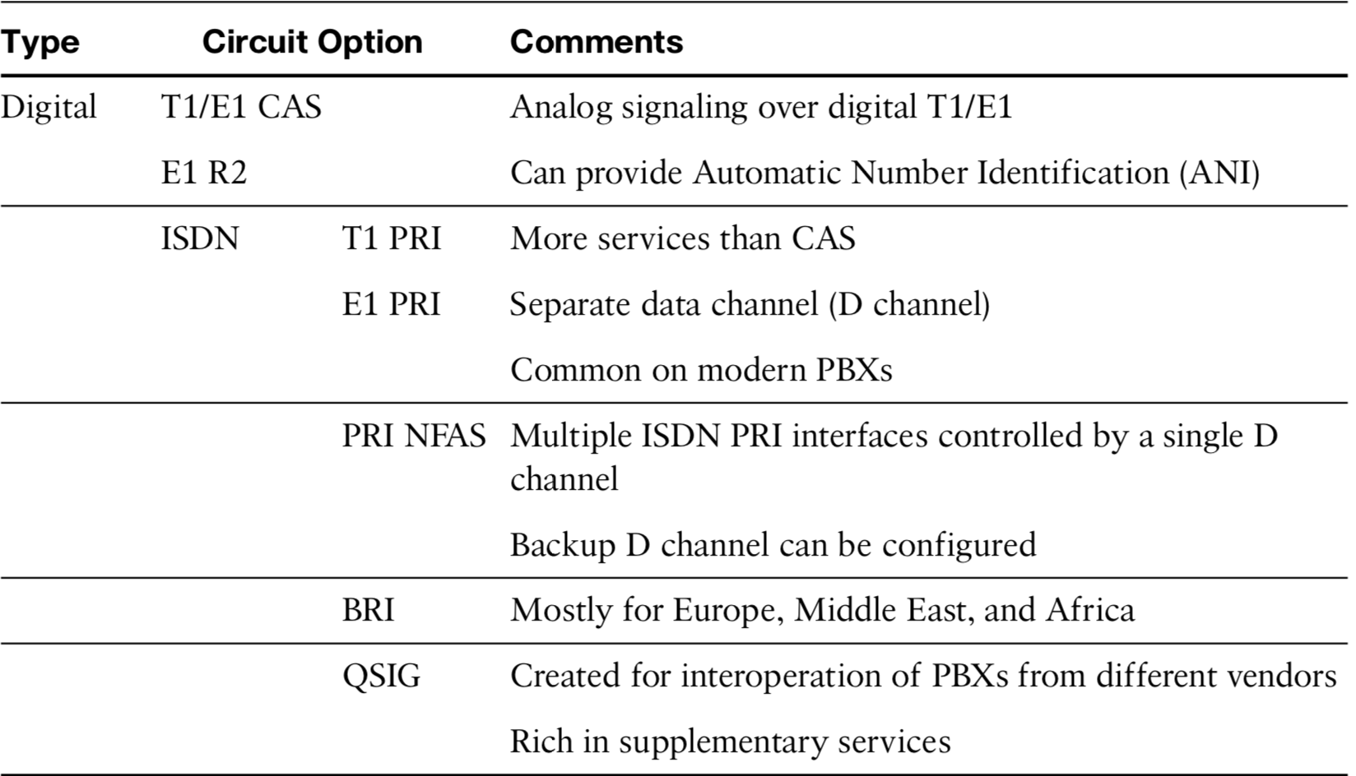
Digital Trunks cont.

Slide 11
T1 CAS Trunk
A T1 circuit is dedicated, high-speed digital connection that can be used for voice and data traffic.
A T1 circuit consists of 24 channels, which can be allotted to voice, data, or both.
Each T1 circuit provides 1.54 Mbps of synchronous bandwidth.
Multiple circuits can be bonded together to increase bandwidth.
T1 CAS Trunk circuit allows analog signaling via a digital T1 circuit.
Many CAS variants operate over analog and digital interfaces.
The type of signaling most commonly used with T1 CAS is E&M signaling.
In addition to setting up and tearing down calls, CAS provides the receipt and capture of dialed number identification (DNIS) and ANI information

Slide 12
T1 CAS Trunk cont.
T1 circuits use TDM to transmit digital data (1s and 0s) instead of the old analog signals.
A single digital voice channel requires 64 kbps of bandwidth which is a standard known as digital signal level 0 (DS0)
With 24 voice channels at 64 kbps per channel, a T1 represents 1.536 Mbps of data.
Add an additional 8 kbps for framing, and the total speed of a T1 circuit comes to 1.544 Mbps.
T1 CAS uses the same signaling types available for analog trunks: loop start, ground start, and E&M variants such as wink-start, delay-start, and immediate-start.

Slide 13
E1 R2 Trunk
An E1 circuit is similar to a T1 circuit.
It is a TDM circuit that carries several DS-0s in one connection.
One big difference between an E1 and a T1 is that an E1 bundles 32 time slots instead of 24.
This results in a bandwidth of 2.048 Mbps.
With an E1, one time slot is used for framing and one is used for signaling.
This leaves 30 time slots available for user data.
The two elements to R2 signaling are line signaling (supervisory signals) and inter-register signaling (call setup control signals).

Slide 14
ISDN
Another protocol used for digital trunks is ISDN.
ISDN is a circuit-switched telephone network system designed to allow digital transmission of voice and data over ordinary telephone copper wires
ISDN has better quality and higher speeds than is available with PSTN system.
ISDN involves the digitization of the telephone network, which permits voice, data, text, graphics, music, video, and other source material to be transmitted over existing telephone wires.

Slide 15
ISDN Services
In contrast to the CAS and R2 signaling, which provide only Dialed Number Identification Service (DNIS), ISDN offers additional supplementary services such as Call Waiting and Do Not Disturb (DND)

Slide 16
ISDN Signaling
ISDN uses Q.921 as its Layer 2 signaling protocol and Q.931 as its Layer 3 signaling protocol.

Slide 17
Time-division multiplexing (TDM)
Topic Two

Slide 18
Time-division Multiplexing (TDM)
Connecting voice devices to a network infrastructure requires an in-depth understanding of the signaling and electrical characteristics specific to each type of interface.
Improperly matched electrical components can cause echo and create poor audio quality.
Configuring devices for international implementation requires knowledge of country- specific settings.

Slide 19
Voice Ports Cont.
Voice ports on routers and access servers emulate physical telephony switch connections.
This ensures that voice calls and their associated signaling can be transferred intact between a packet network and a circuit-switched network or device.
For a voice call to occur, certain information (referred to as signaling) must be passed between the telephony devices at either end of the call such as:
the on-hook status of the devices,
the availability of the line,
and whether an incoming call is trying to reach a device.

Slide 20
Signaling Interfaces
Voice ports on routers and access servers physically connect the router, access server, or call control device to telephony devices such as telephones, fax machines, PBXs, and PSTN central office (CO) switches through signaling interfaces.
Analog signaling interfaces include FXO, FXS, and E&M
Digital signaling interfaces include T1, E1, and ISDN

Slide 21
Analog Voice Ports
Analog voice port interfaces connect routers in packet-based networks to analog two- wire or four-wire circuits in telephony networks.
Two-wire circuits connect to analog telephone or fax devices, and four-wire circuits connect to PBXs.

Slide 22
FXS
FXS (Foreign Exchange Subscriber) is a port that connects the router or access server to end-user equipment such as office phones, fax machines, or modems.
The FXS interface supplies ring, voltage, and dial tone to the station and includes an RJ-11 connector for basic telephone equipment, key sets, and PBXs.

Slide 23
FXO
FXO (Foreign Exchange Office) is the port on the end communication device that receives the analog line on the telephone or fax machine.
In order for a call to work, a telecommunication line from an FXO port must be connected to an FXS port, and vice versa.
The process for making calls is simple: when your FXS and FXO ports are connected, you will receive a signal from the telephone company through the FXS port in the wall
This signal is then transmitted to the FXO port connected to the device so that, when you pick up the phone, you hear the dial tone.

Slide 24
Ear & Mouth (E&M)
Trunk circuits connect telephone switches to one another. They do not connect end-user equipment to the network.
The most common form of analog trunk circuit is the E&M interface, which uses special signaling paths that are separate from the trunk audio path to convey information about the calls.
E&M connections from routers to tele- phone switches or to PBXs are preferable to FXS and FXO connections because E&M provides better answer and disconnect supervision.

Slide 25
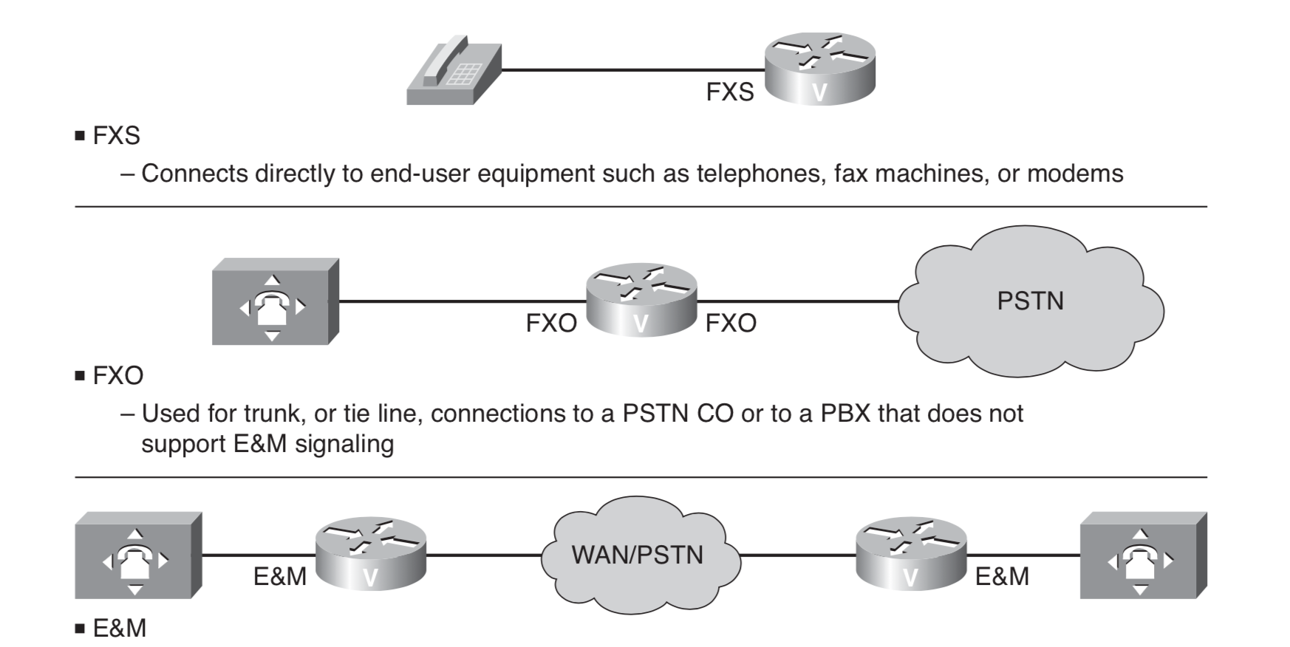
Common Forms of Analog Trunk Circuit

Slide 26
Analog Signaling
Signaling techniques can be placed into one of three categories:
Supervisory: Involves the detection of changes to the status of a loop or trunk. When these changes are detected, the supervisory circuit generates a predetermined response. A circuit (loop) can close to connect a call, for example.
Addressing: Involves passing dialed digits (pulsed or tone) to a PBX or CO. These dialed digits provide the switch with a connection path to another phone or customer premises equipment (CPE).
Informational: Provides audible tones to the user, which indicates certain conditions such as an incoming call or a busy phone.

Slide 27
FXS and FXO Supervisory Signaling
FXS and FXO interfaces indicate on-hook or off-hook status and the seizure of telephone lines by one of two access signaling methods: loop-start or ground-start.
The type of access signaling is determined by the type of service from the telephone company’s Central Office(CO).
Ground start is a method of signaling from a terminal of a subscriber local loop to a telephone exchange, where one side of a cable pair is temporarily grounded to request dial tone.
Loop start is a a signaling technique in which a party gets a dial tone by closing a DC current loop.
loop start systems are vulnerable to an issue where someone can call you at the same time as you are attempting to place a telephone call.

Slide 28
Informational Signaling
The FXS port provides informational signaling using call progress (CP) tones
These CP tones are audible and are used by the FXS connected device to indicate the status of calls.
These include the following:
Dial tone: Indicates that the telephone company is ready to receive digits from the user telephone.
Busy tone: Indicates that a call cannot be completed because the telephone at the remote end is already in use.
Ring-Back (normal or PBX): Tone indicates that the telephone company is attempting to complete a call on behalf of a subscriber.

Slide 29
Informational Signaling cont.
Congestion: Progress tone is used between switches to indicate that congestion in the long-distance telephone network currently prevents a telephone call from being processed.
Reorder: Tone indicates that all the local telephone circuits are busy and thus prevents a telephone call from being processed.
Receiver off-hook: Tone is the loud ringing that indicates the receiver of a phone is left off-hook for an extended period of time.
No such number: Tone indicates that the number dialed cannot be found in the routing table of a switch.

Slide 30
E&M Address Signaling
PBXs built by different manufacturers can indicate on-hook/off-hook status and telephone line seizure on the E&M interface by using any of three types of access signaling:
Immediate-start Here the calling side places trunk off hook and originating switch transmits dial digits.
Wink-start the calling side seizes the line by going off-hook first, remote switch transmit off hook pulse, and originating switch transmits dial digits (address information).
Delay-start the calling station seizes the line by going off-hook on and waits. After a timed interval, the calling side looks at the status of the called side. If the called side is on-hook, the calling side starts sending information

Slide 31
Configuring Analog Voice Ports
Topic Three

Slide 32
FXS Voice Port Configuration
Step 1 Enter voice-port configuration mode.
Router(config)# voice-port slot/port
Step 2 Select the access signaling type to match the telephony connection you are making.
Router(config-voiceport)# signal {loopstart | groundstart}
Step 3 Select the two-letter locale for the voice call progress tones and other locale- specific parameters to be used on this voice port.
Router(config-voiceport)# cptone locale

Slide 33
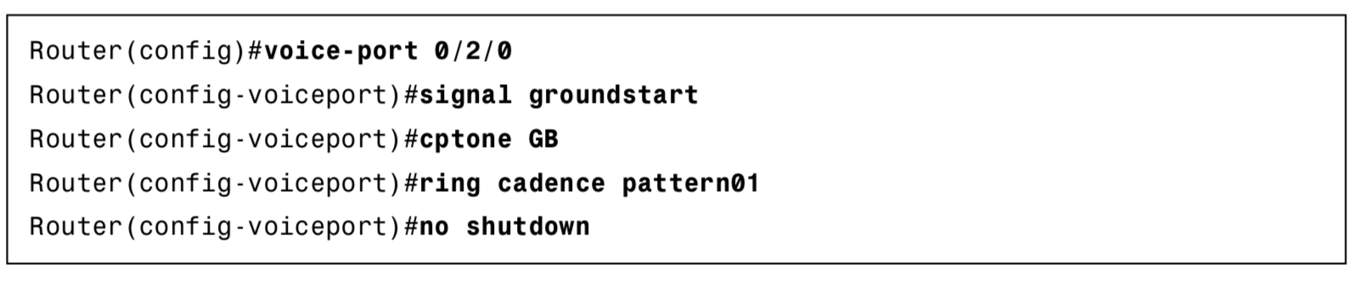
FXS Voice Port Configuration cont.
Step 4 Specify a ring pattern. Each pattern specifies a ring-pulse time and a ring-interval time.
Router(config-voiceport)#ring cadence {pattern-number | define pulse interval}
Step 5 Activate the voice port.
Router(config-voiceport)#no shutdown

Slide 34
FXO Voice Port Configuration
Step 1 Enter voice-port configuration mode.
Router(config)#voice-port 0/0/0
Step 2 Select the access signaling type to match the telephony connection you are making
Router(config-voiceport)#signal ground-start
Step 3 Specify a PLAR off-premises extension (OPX) connection
Router(config-voiceport)#connection plar opx 4001

Slide 35
FXO Voice Port Configuration cont.
Step 4 Activate the voice port
Router(config-voiceport)#no shutdown
Step 5 Exit voice port configuration mode.
Router(config-voiceport)#exit
Step 6 Create a standard dial peer for inbound and outbound PSTN calls.
Router(config)#dial-peer voice 90 pots
Step 7 Specify the destination pattern.
Router(config-dialpeer)#destination-pattern 9T
Specify the voice port associated with this dial peer.
Router(config-dialpeer)#port 0/0/0

Slide 36
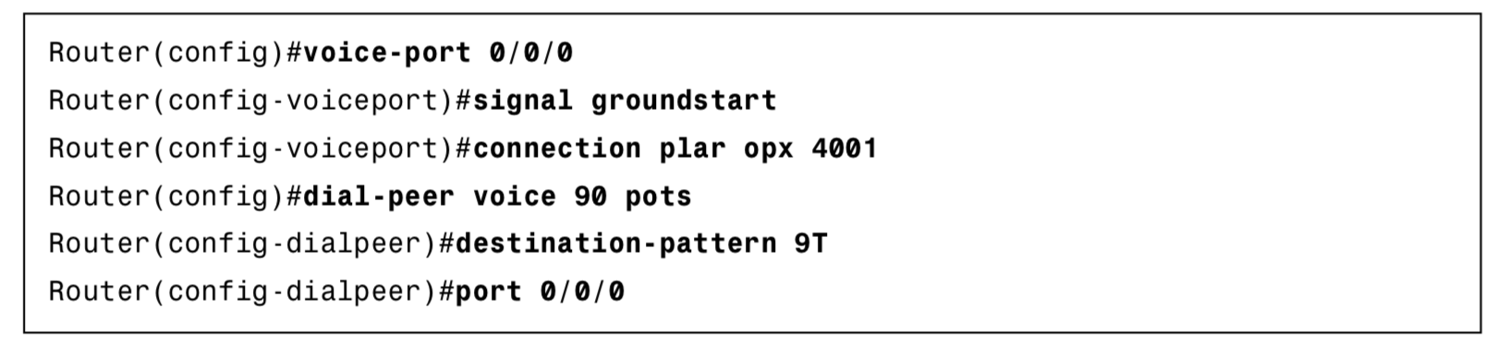
FXO Voice Port Configuration Example
POTS- Short for Plain Old telephone Service, which refers to the standard telephone service that most homes use.

Slide 37
E&M Voice Port Configuration
Configuring an E&M analog trunk is straightforward.
Three key options have to be set:
The signaling E&M signaling type
Two- or four-wire operation
The E&M type

Slide 38
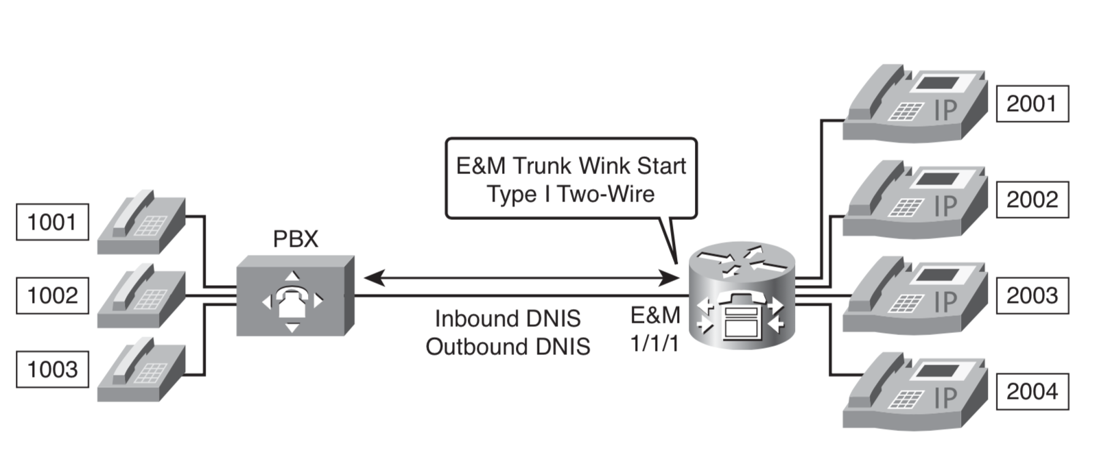
Example: E&M Configuration Topology
In this example, you have been assigned to configure a voice gateway to work with an existing PBX system according to network requirements. You must set up a voice gateway to interface with a PBX to allow the IP phones to call the POTS phones using a four-digit extension.

Slide 39
Example: E&M Configuration Topology
The configuration requirements are the following:
Configure the voice port to use wink-start signaling.
Configure the voice port to use 2-wire operation mode.
Configure the voice port to use Type I E&M signaling.
Configure a standard dial peer for the POTS phones behind the PBX.

Slide 40
E&M Configuration
Step 1 Enter voice-port configuration mode
Step 2 Select the access signaling type to match the telephony connection desired
Router(config-voiceport)#signal wink-start
Step 3 Select a specific cabling scheme for the E&M port.
Router(config-voiceport)#operation 2-wire
Step 4 Specify the type of E&M interface
Router(config-voiceport)#type 1
Step 5 Activate the voice port.
Router(config-voiceport)#no shutdown
Step 6 Exit voice port configuration mode.
Router(config-voiceport)#exit

Slide 41
E&M Configuration cont.
Step 7 Create a dial peer for the POTS phones.
Router(config)#dial-peer voice 10 pots
Step 8 Specify the destination pattern for the POTS phones.
Router(config-dialpeer)#destination-pattern 1...
Step 9 Specify direct inward dial.
Router(config-dialpeer)#direct-inward-dial
Step 10 Specify digit forwarding all, so that no digits will be stripped as they are for- warded out of the voice port.
Router(config-dialpeer)#forward-digits all
Step 11 Specify the voice port associated with this dial peer.
Router(config-dialpeer)#port 1/1/1

Slide 42
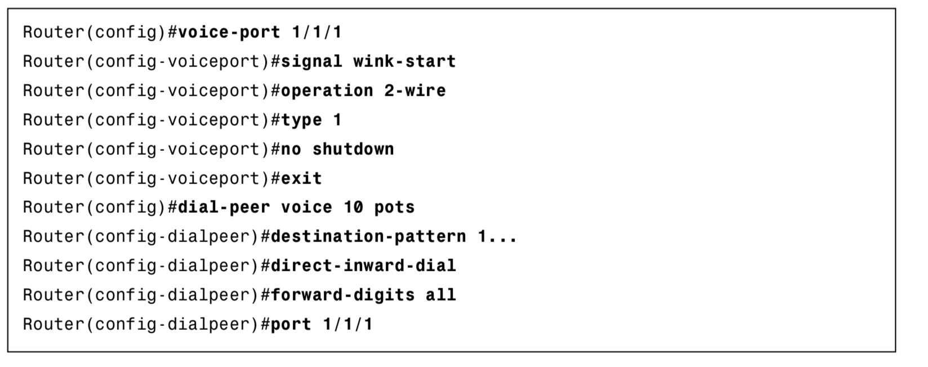
E&M Configuration Example

